Slide 1
E-commerce Product Demand & Sales Analysis
Training Project Report
Data Engineering: Batch 4
Presented by:
HANIF MOHAMMED, KATHYAYINI, INDHUJA RAVI, HARSHA

Slide 2
Project Overview
Goal: Predict e-commerce product demand and support business decisions.
• Tech Stack: Azure Databricks, Azure Blob Storage, MLflow, Azure Data Factory, Azure DevOps, ADX.
• Approach: Medallion Architecture (Bronze, Silver, Gold) with CI/CD and MLOps.

Slide 3
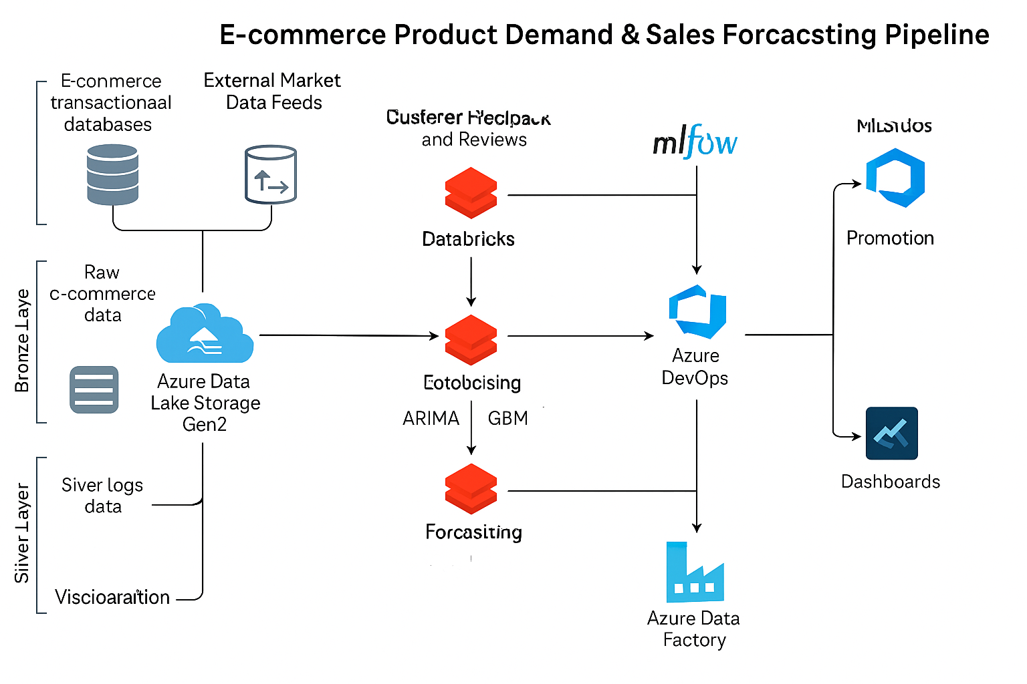

Slide 4
Data Ingestion – Bronze Layer
Source: RetailRocket dataset from Kaggle.
• Tool: Azure Databricks + Kaggle API.
• Storage: Azure Data Lake Storage Gen2 (Bronze).

Slide 5
Data Transformation – Silver Layer
Tool: PySpark in Azure Databricks.
• Aggregated daily item-wise sales.
• Stored in Delta Lake format for performance & reliability.

Slide 6
Forecasting Model – Gold Layer
Models: ARIMA, Simple Moving Average, GBM, Prophet, Custom Python.
• Top 5 active items forecasted for next 7 days.
• Tracked using MLflow (version, params, metrics).

Slide 7
ML CI/CD with Azure DevOps
Pipeline written in YAML, triggered on main branch commits.
• Stages: Staging → Production with approval flow.
• Rollback and integration with ADF & MLflow supported.

Slide 8
Pipeline Orchestration – ADF
Azure Data Factory orchestrates Databricks notebooks.
• Sequential execution ensures Bronze → Silver → Gold pipeline integrity.
• Monitored through ADF pipeline UI.

Slide 9
Visualization using Azure Data Explorer
Forecasted data ingested from Gold Layer.
• KQL used for querying and rendering dashboards.
• Interactive dashboards built for business insights.

Slide 10
Conclusion
Scalable, automated demand forecasting pipeline implemented.
• Supports data-driven decisions in inventory and supply chain.
• Follows industry best practices for Data Engineering & MLOps.

